Slide 1
Data Jobs in Demand
April 3, 2019
Elena Portz
Khrizel Solano
Valarmathi Pukuraj
Ratan Hodar
Notes:
ELENA

Slide 2
Background
Some of us want new jobs
Dataset: Indeed Data Job listings (source: Kaggle)
Aug 2018
Est salary range
6964 rows x 5 cols
Notes:
ELENA -
Some of us want us new jobs or new skills. We decided to go with Indeed from Kaggle & had data that we found interesting based on what we would be looking for as a job hunter such as: (bullet points)
Recommend to UC Berkeley Data Analytics Bootcamp graduates the most in demand data job category (data analyst, data scientist, and data engineer) in CA and within US based on several factors.

Slide 3
Hypotheses
Job openings by location CA vs. US?
Company size vs. happiness?
Salary and satisfaction?
Internet/Software category dominance
Most valued skills: Python and SQL
Notes:
ELENA
We had a few hunches and used our hypothesis such as
-prediction for tech openings by location
- employers in larger companies are happier
- employees are satisfied based on higer salary
-
There are more job openings for data jobs in CA compared to other US states

Slide 4
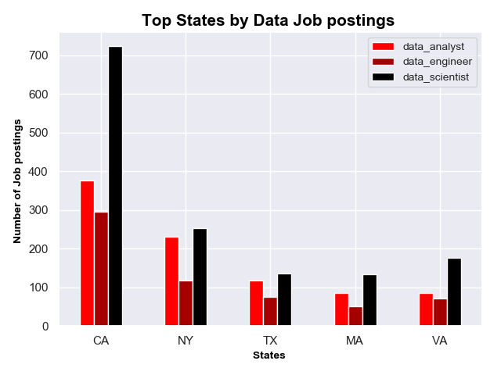
Company Job Postings by Top States
Notes:
In the next 3 slides I’ll be talking about our findings regarding company data. This graph showins

Slide 5
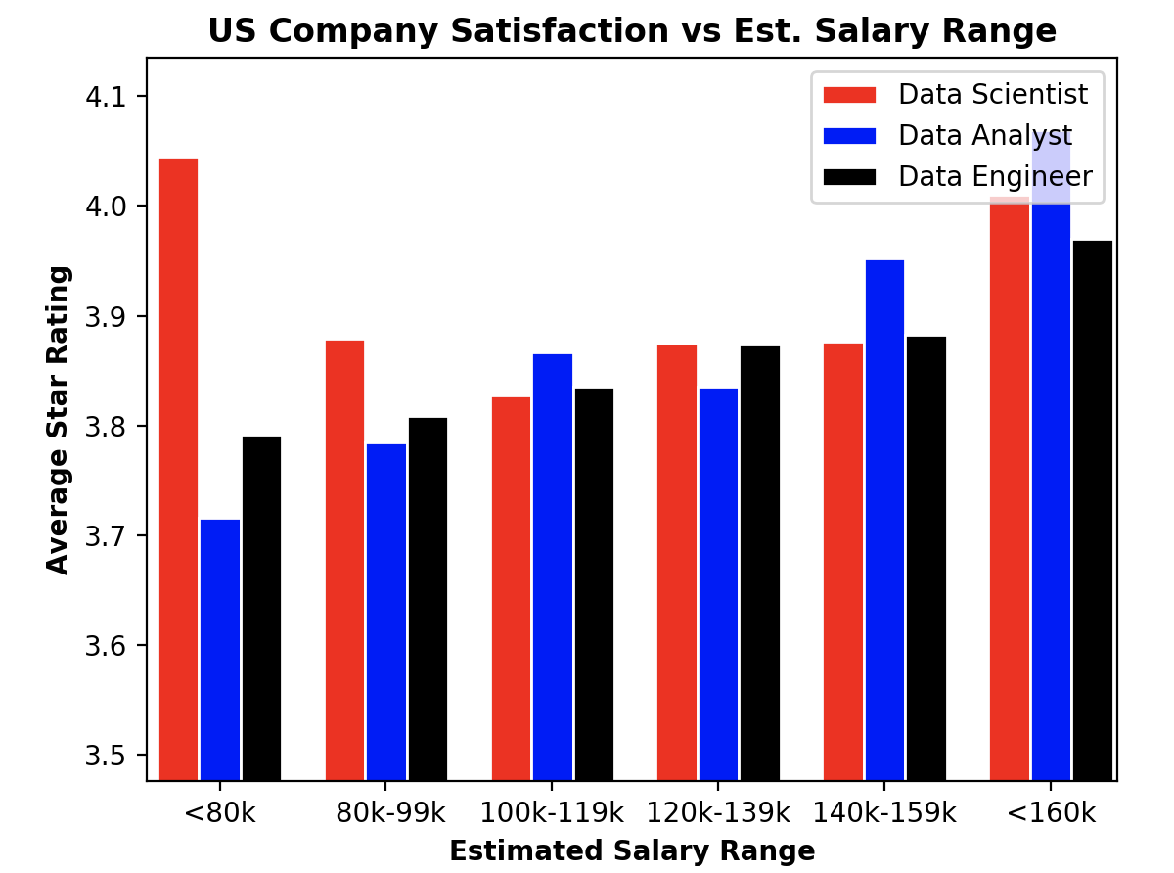
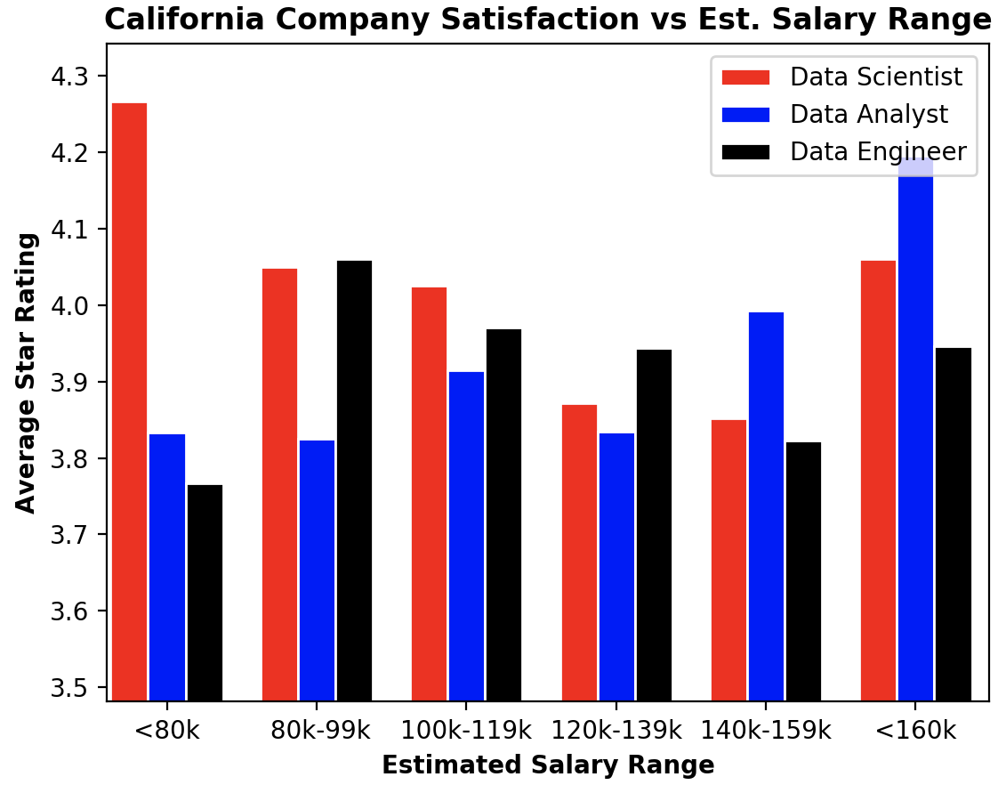
Company Satisfaction vs Est. Salary Range
Notes:
KHRIZEL
Estimate one of the reasons Indeed
Though it goes against our hypothesis -
Average star
We have done box plots and means meaningful tightly

Slide 6
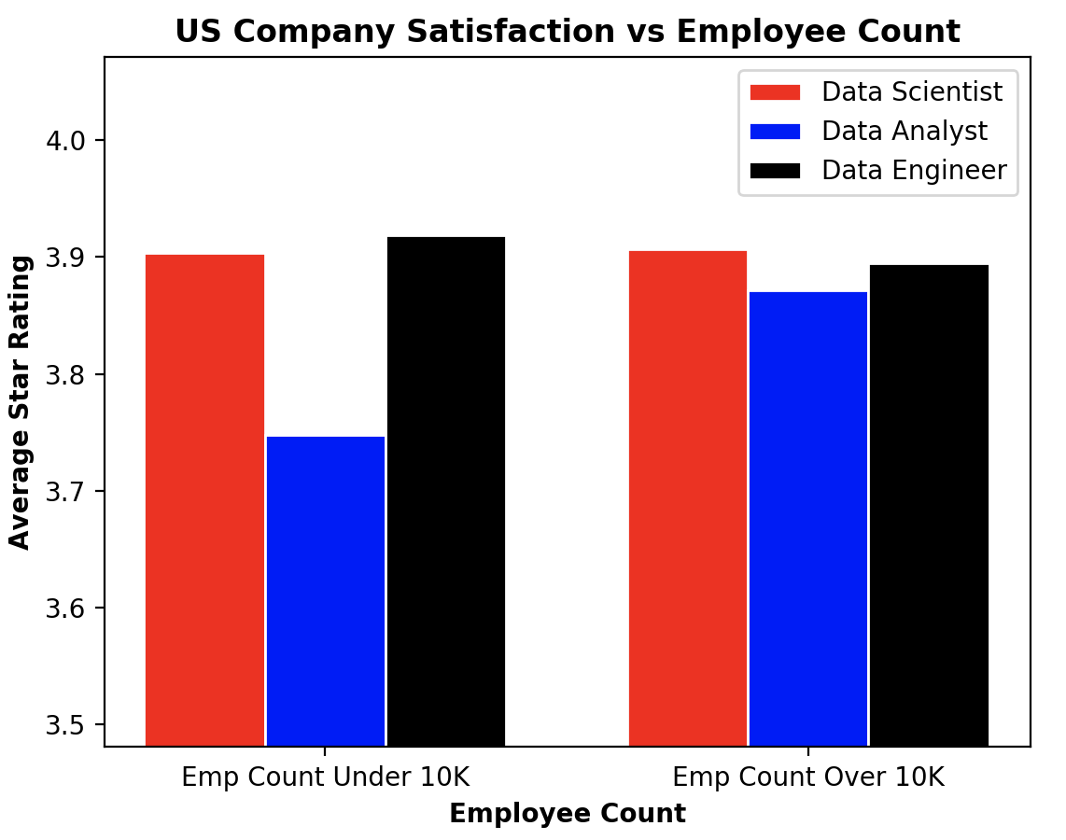
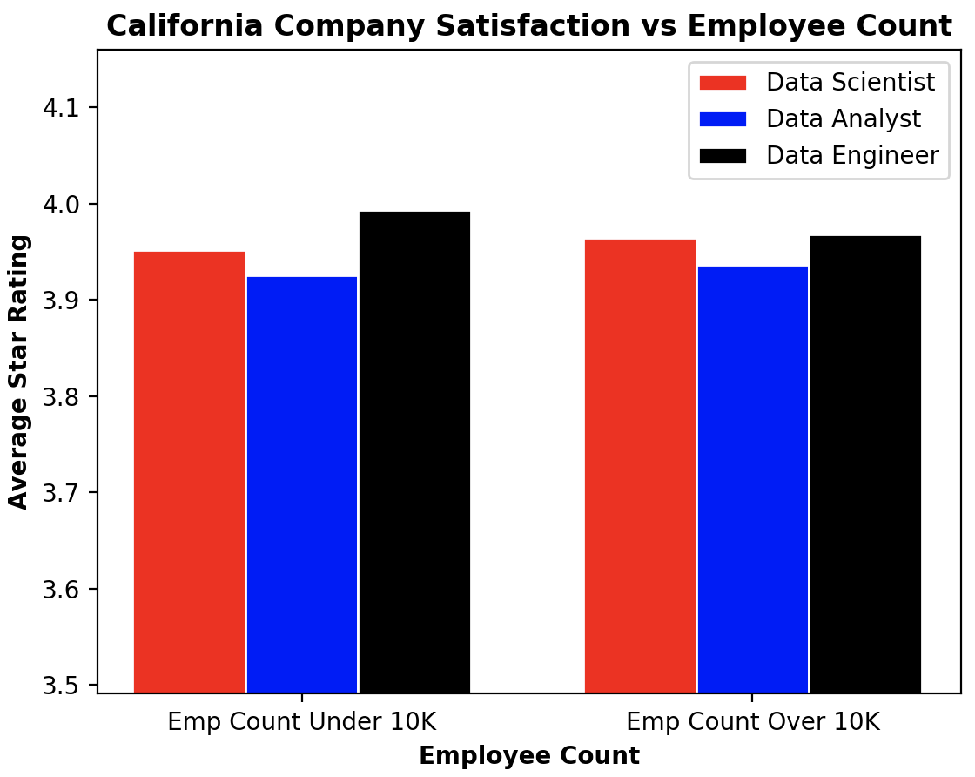
Company Satisfaction vs Company Size
Notes:
KHRIZEL - data analyst makes a difference (avg level happier in a bigger company)

Slide 7
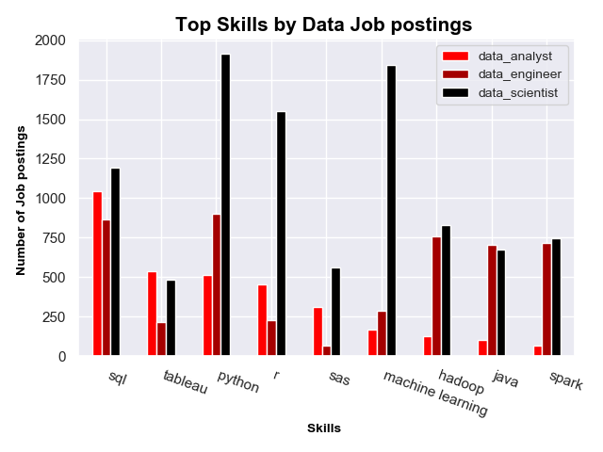
Top Skills
Notes:
VALAR

Slide 8
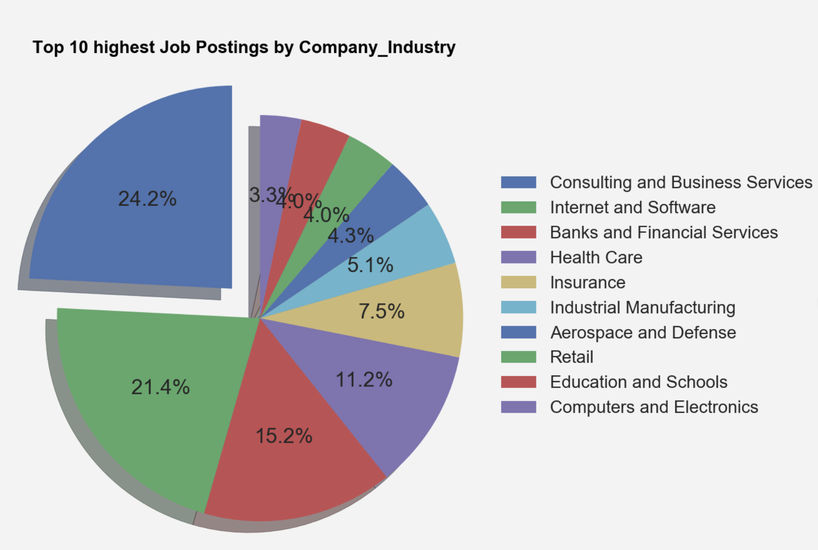
Top 10 Postings by Industry
Notes:
VALAR

Slide 9
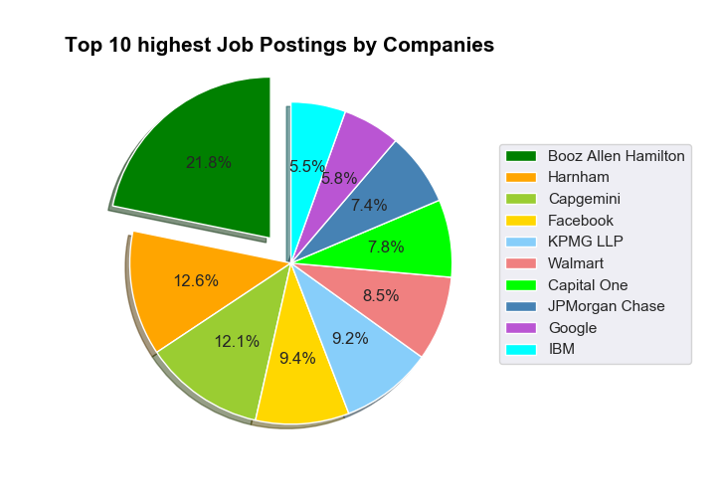
Top 10 Postings By Companies
Notes:
VALAR

Slide 10
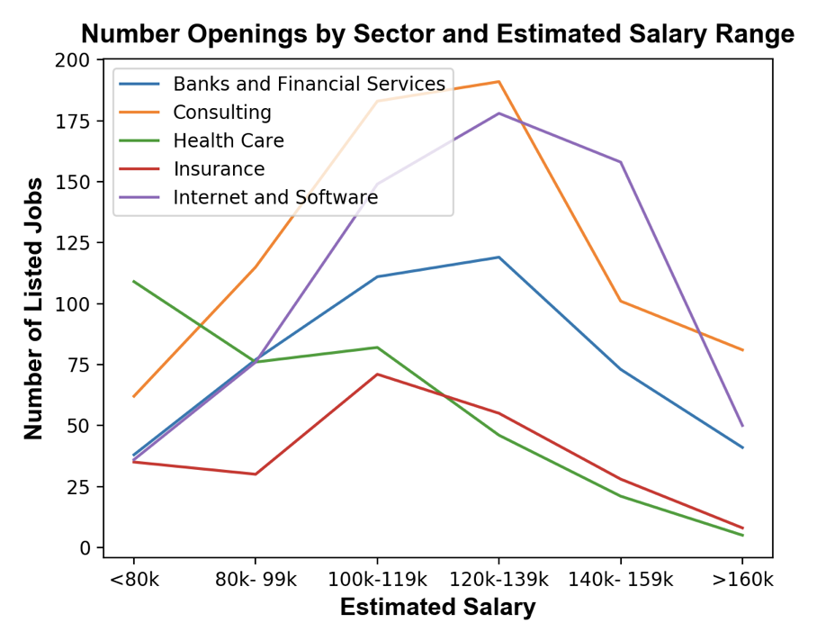
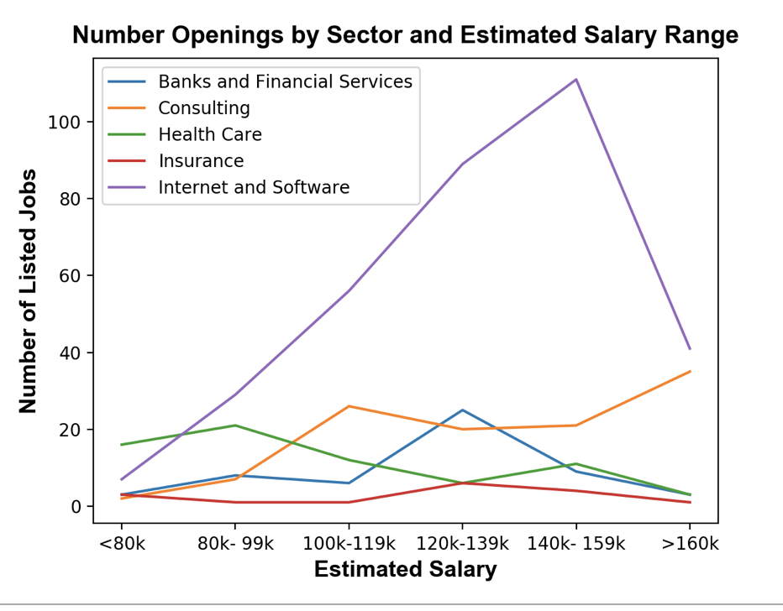
Estimated Salary By industry
US (100%)
CA (24.44%)
Notes:
RATAN
There may be a better way to compare these two… like having matching Y axes scales? Do we need to show both at all?
Software data jobs is more in CA most of the other industries are outside CA

Slide 11
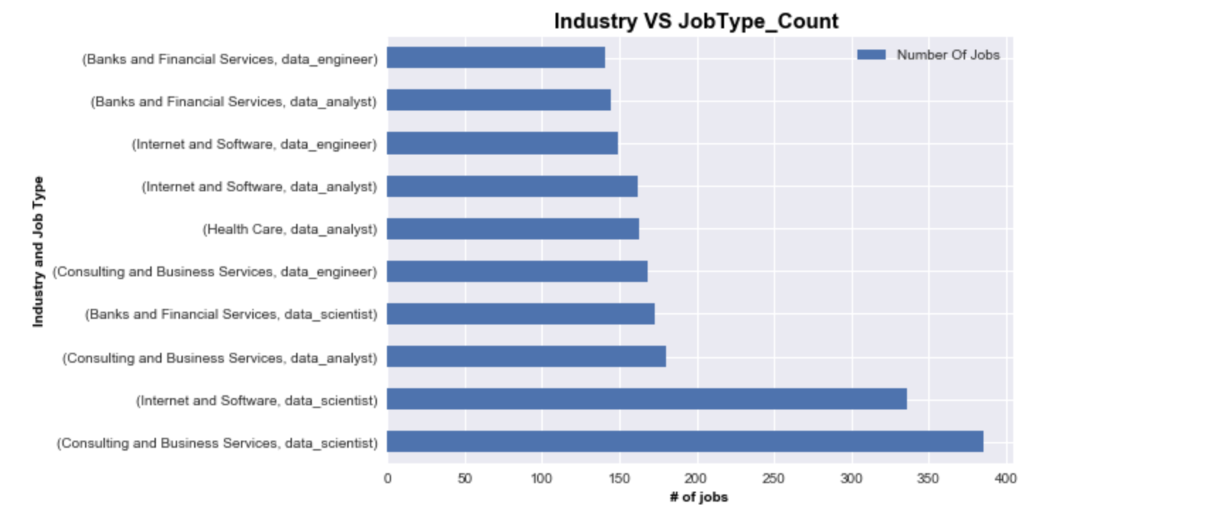
Industry vs Job Type
Notes:
RATAN

Slide 12
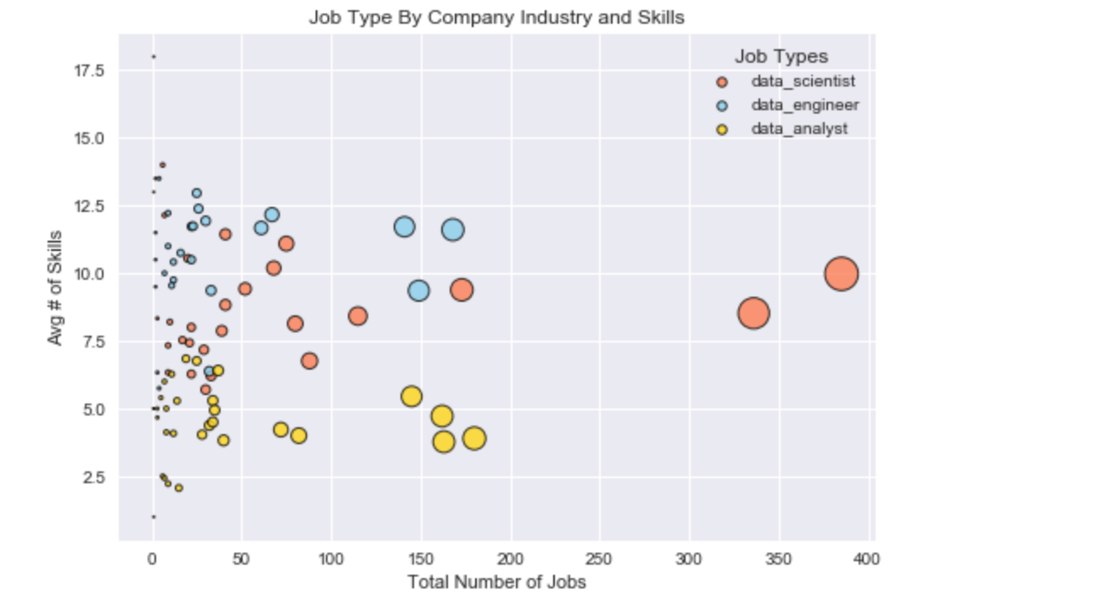
Avg Skills vs Job Type
Notes:
RATAN

Slide 13
Problems and Solutions
2 data sets - Indeed and LinkedIn
Parsing through job description
Data set limitation
Size over 10K or under 10K
Date range
Notes:
RATAN

Slide 14
Conclusions
Most jobs postings in CA
Majority positions are in Consulting category
The “happiest” people make the most and least
most in demand job skill for data jobs:
Python
SQL
Notes:
RATAN

Slide 15
Future Directions
API
Better categorization different experience level
More data sets
More statistical analysis
Notes:
RATAN

Slide 16
Appendices

Slide 17
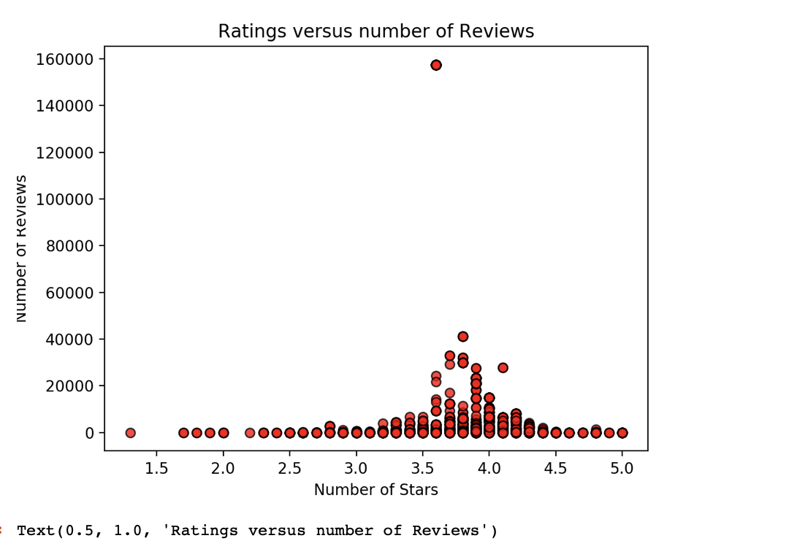
Company Ratings vs Reviews
Notes:
RATAN
More reviews bigger companu size
Less reviews vs rating

Slide 18
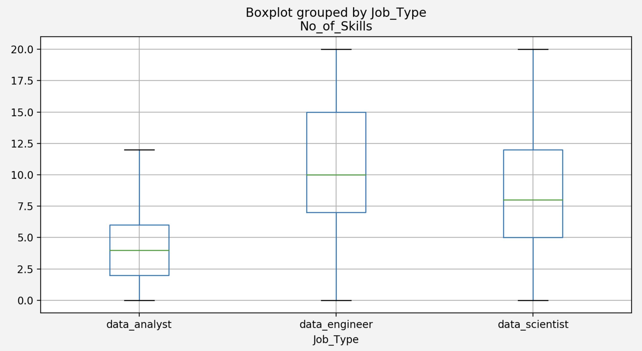
ANOVA # Skills vs Job Type
Notes:
Need to still do t-test -> bonferonni correlation

Slide 19
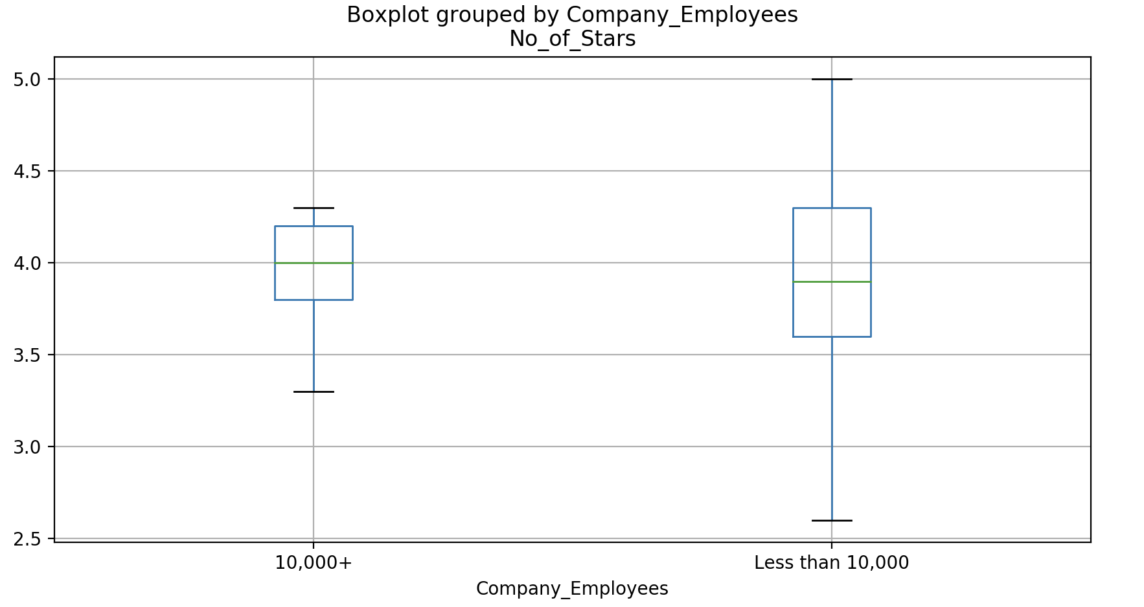
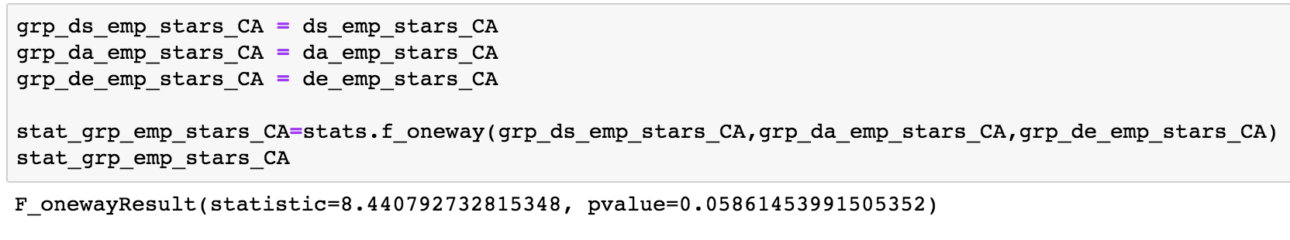
ANOVA CA Company Satisfaction vs Company Size
Notes:
Need to still do t-test -> bonferonni correlation

Slide 20
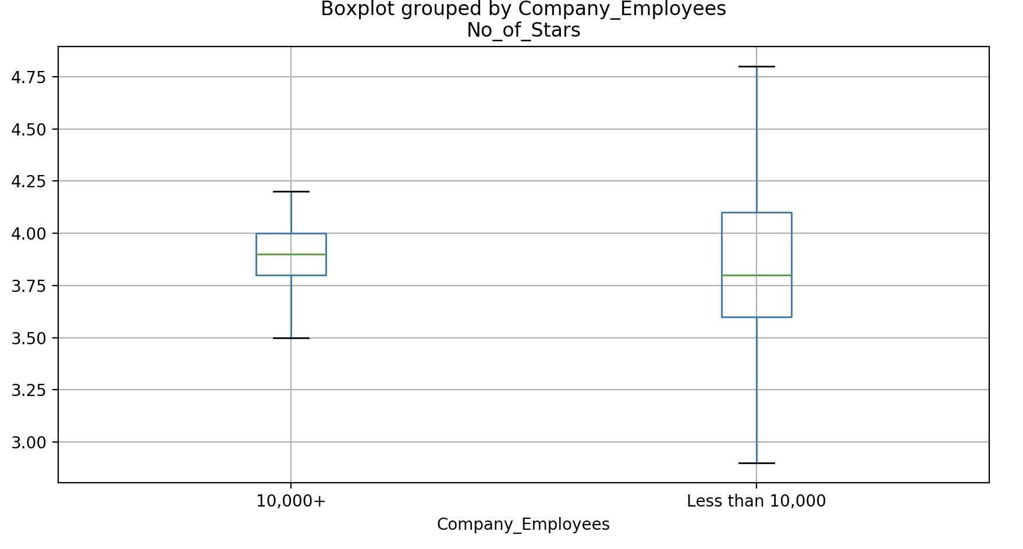
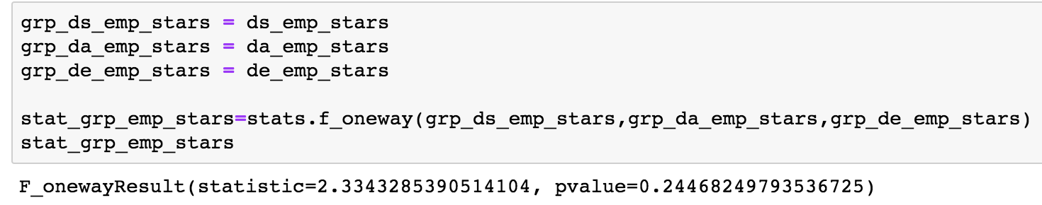
ANOVA US Company Satisfaction vs Company Size
Notes:
Need to still do t-test -> bonferonni correlation

Slide 21
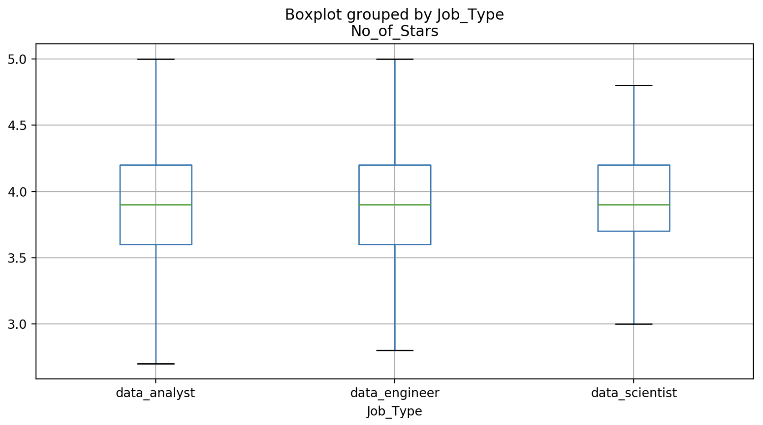
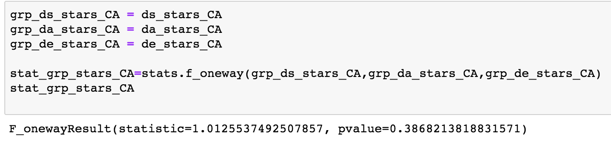
ANOVA CA Job Types vs Company Satisfaction
Notes:
CA Need to still do t-test -> bonferonni correlation

Slide 22
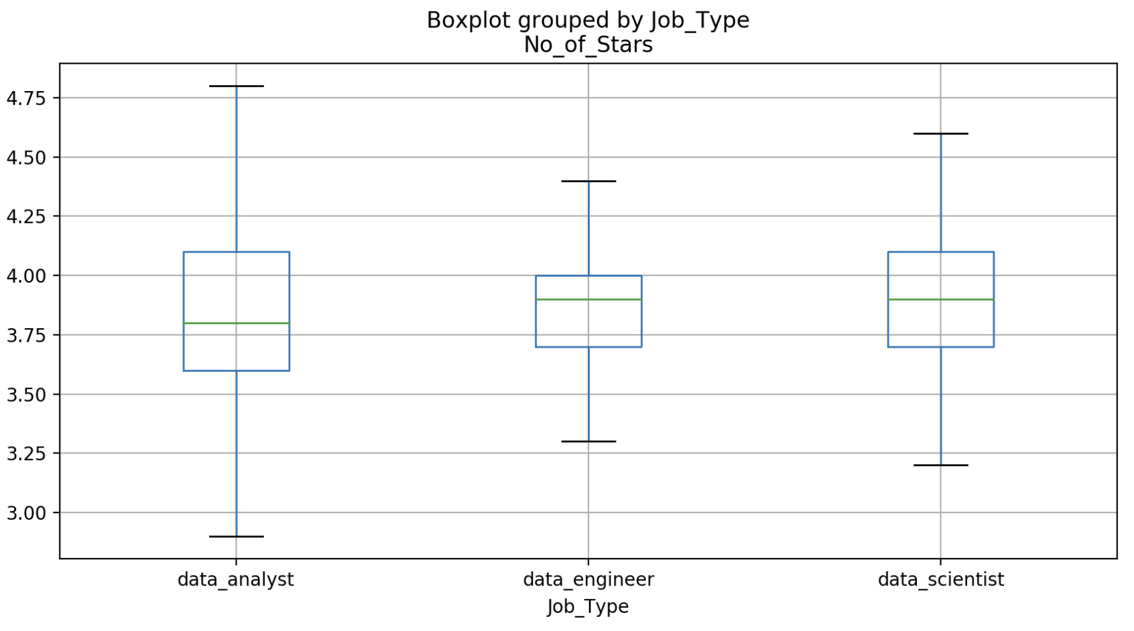
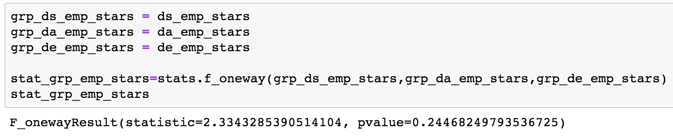
ANOVA US Job Types vs Company Satisfaction
Notes:
US Need to still do t-test -> bonferonni correlation (work on statistical 3 different graphs based on job categories)
Quartile distances tight - higher confidence concentrated toward the centr

Slide 23
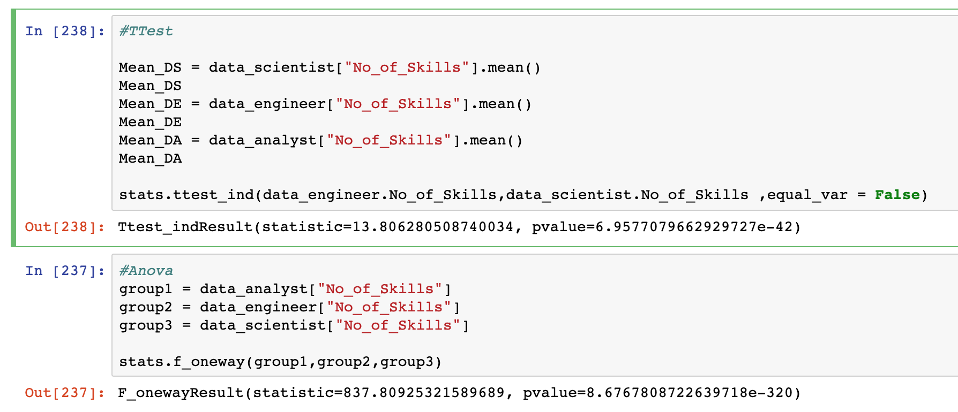
Industry vs # of Jobs
Notes:
RATAN

Slide 24
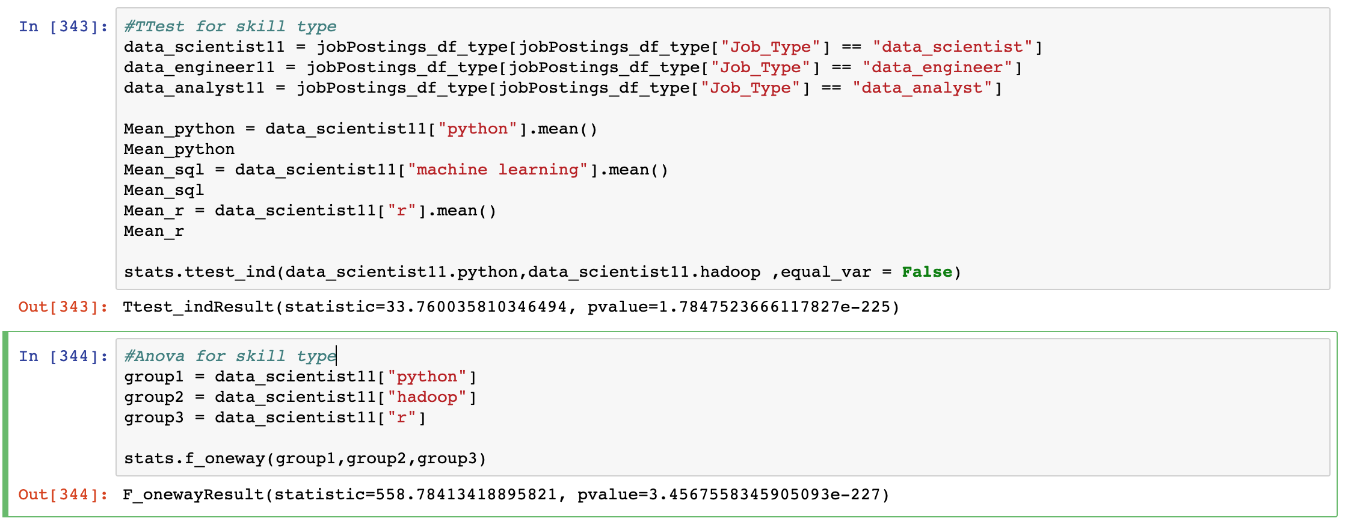
Job Skills
Notes:
RATAN

